Slide 1
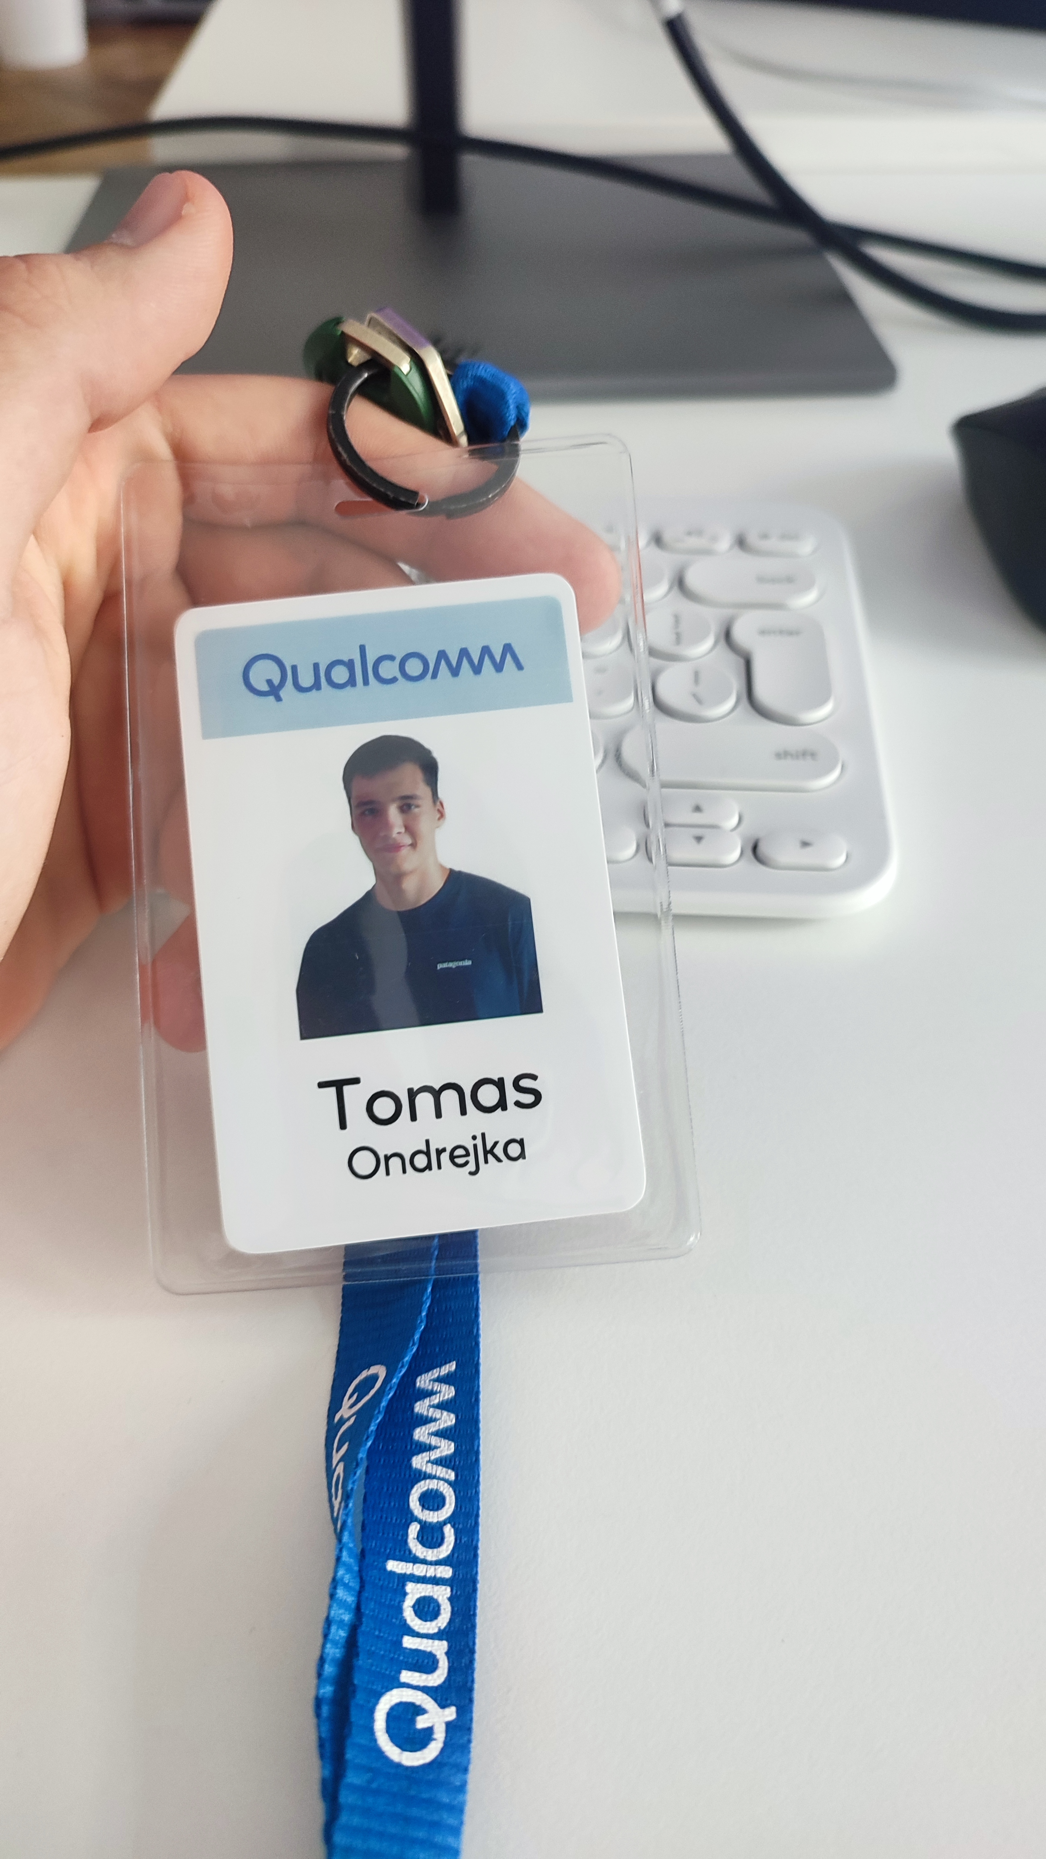
Internship Presentation
Tomas Ondrejka

Slide 2
Outline
Company
Team and Methodology
Responsibilities and improvement
Salzburg
Tips on how to find internship
Conclusion
Disclaimer

Slide 3


Slide 4


Slide 5

Qualcomm

Slide 6


Snapdragon Spaces

Slide 7
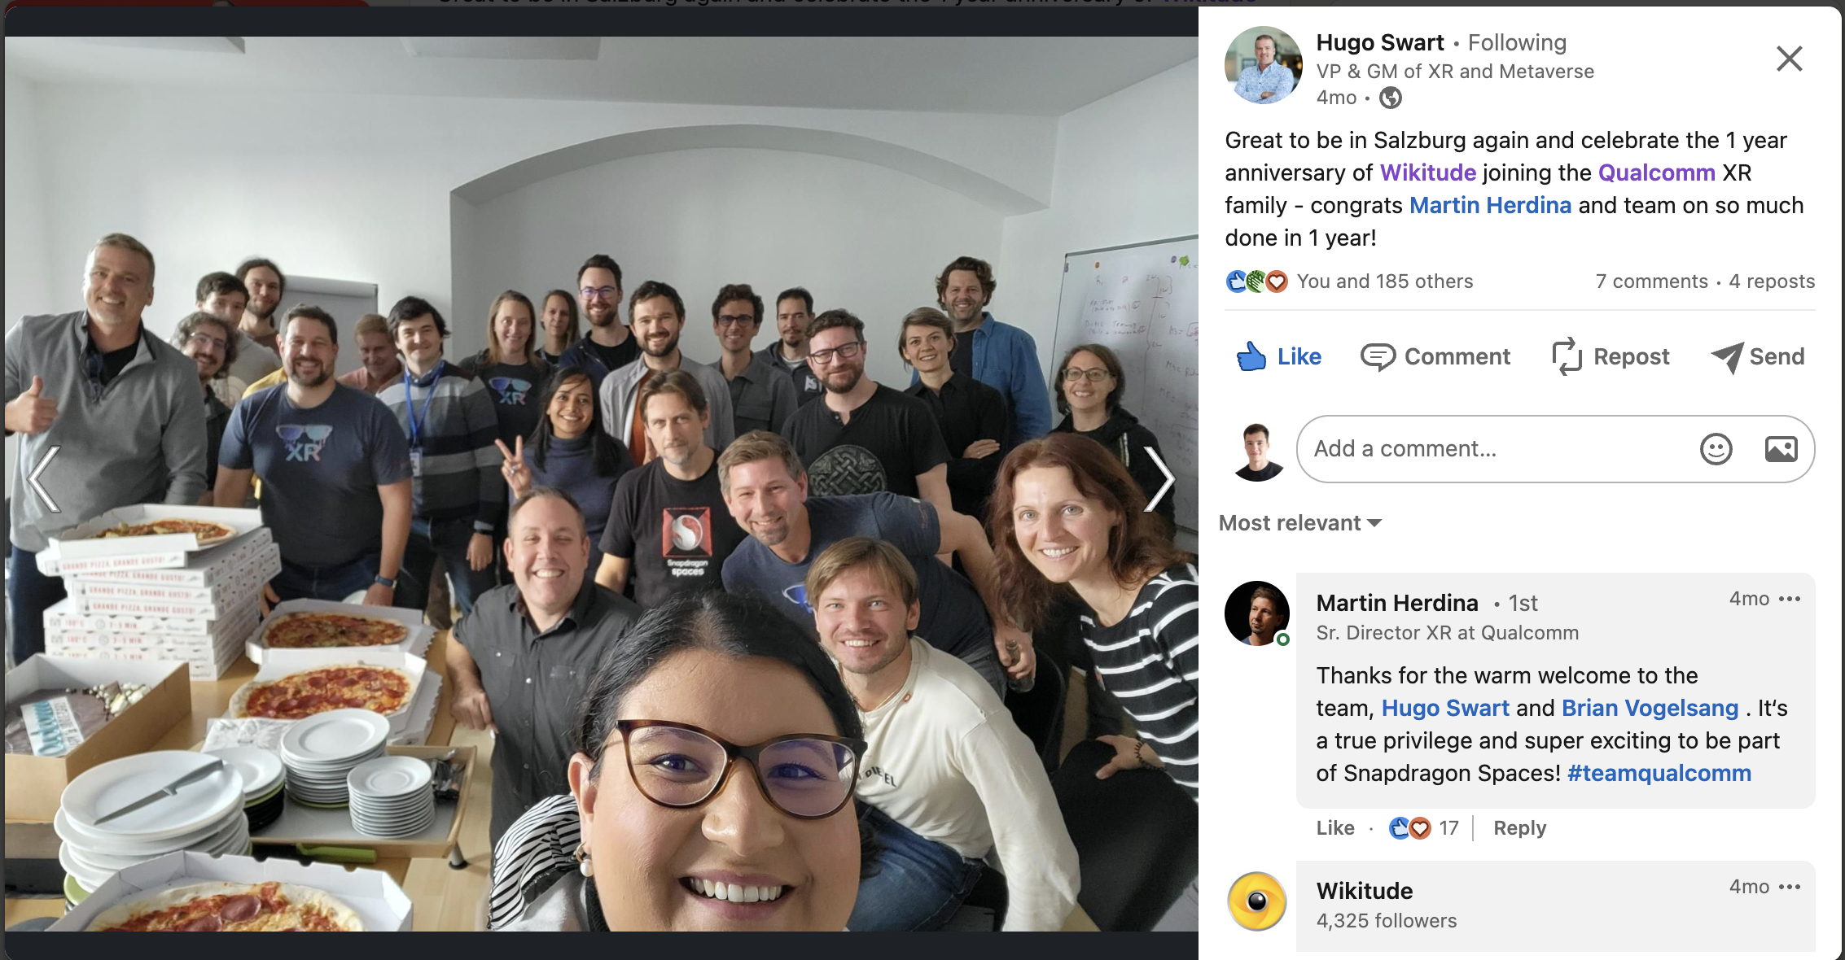
Team

Slide 8


Methodology

Slide 9
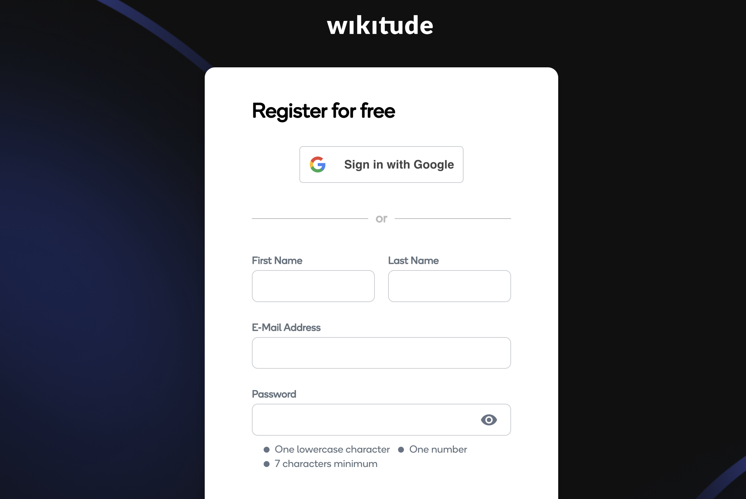
Responsibilities

Slide 10






Improvement

Slide 11





Salzburg

Slide 12

Tips

Slide 13
Conclusion

Slide 14
Disclaimer

Slide 15
Thank you for your attention

